Slide 1
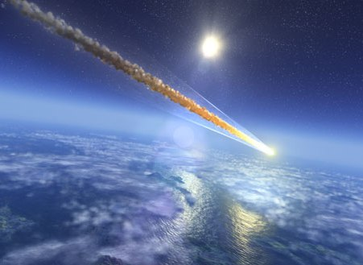
Life in the Shooting Gallery
Planet Earth in the Crosshairs

Slide 2
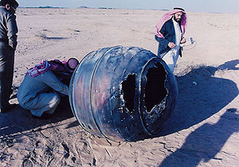
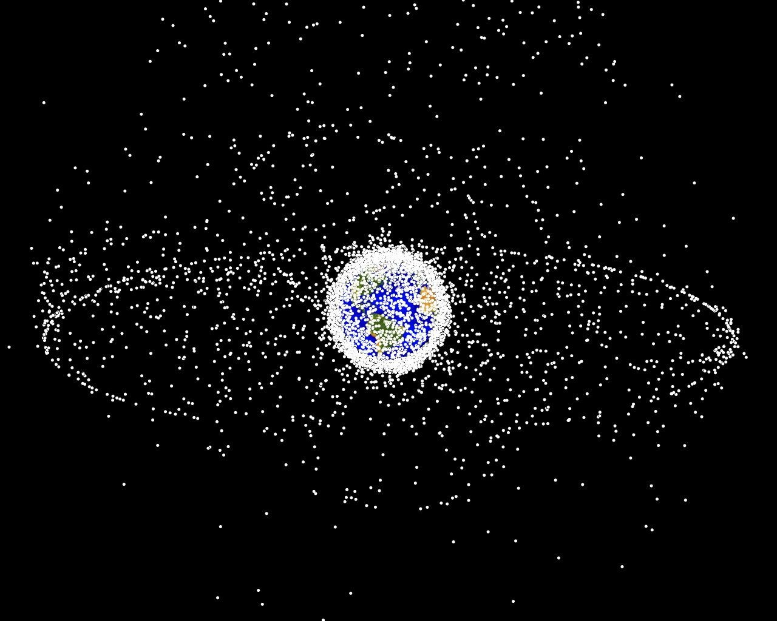
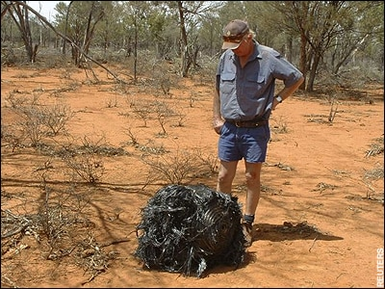
Shooting at ourselves?
What goes up must…

Slide 3

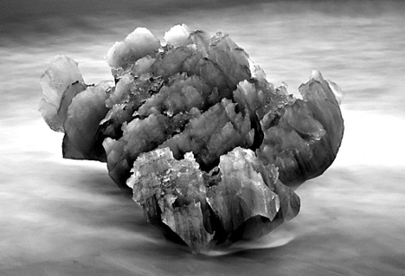
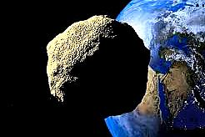
Speeder IDs
Meteoroid - Dust, rock, metal speeding through space.
One molecule to 100 meters – anything bigger is an asteroid.
Meteor – The blazing streak of a meteoroid burning up in the atmosphere. Most are only a sand grain or a pebble.

Slide 4
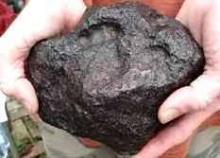
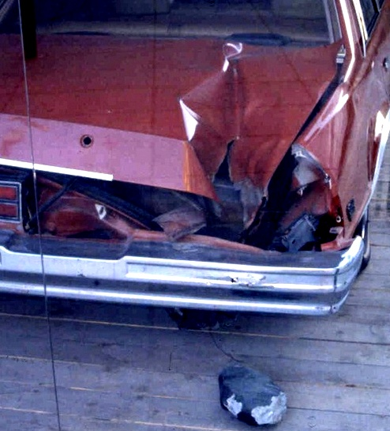
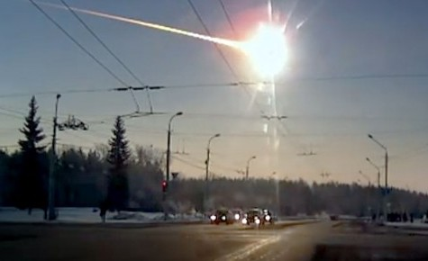
Identified falling objects
Meteorite - A meteoroid that hits the ground... Or something!
Bolide – An exploding meteorite

Slide 5

A Close Call
Oct. 9, 1992, in Peekskill, New York.
The fireball from a 22,000-pound meteorite streaked across the sky. It was visible as far away as Kentucky. A 26 pound fragment of the meteorite struck Michelle Knapp’s car and tore a hole through her Chevy Malibu’s trunk.
She sold the car for $69,000.
It is now in a museum.

Slide 6
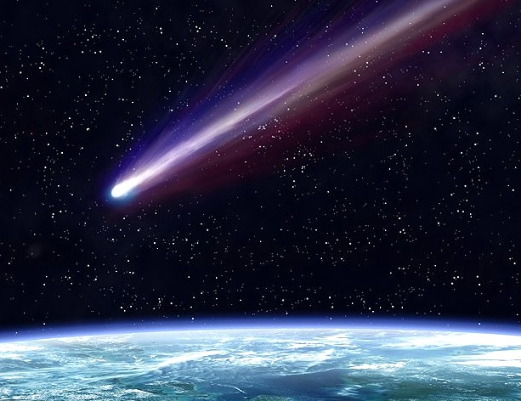

Burn Baby, Burn
Meteoroids hit Earth’s upper atmosphere – 30 to 50 miles up – at 7 to 45 miles per second.
…Highly elliptical orbits are very fast.
…More circular orbits
are slower

Slide 7
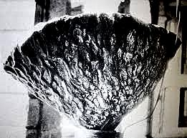
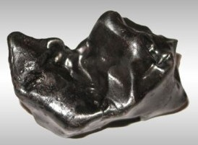

Burn Baby, Burn
Entry temperatures can reach 3,000 degrees F.
Iron melts at around 2750 degrees F.

Slide 8
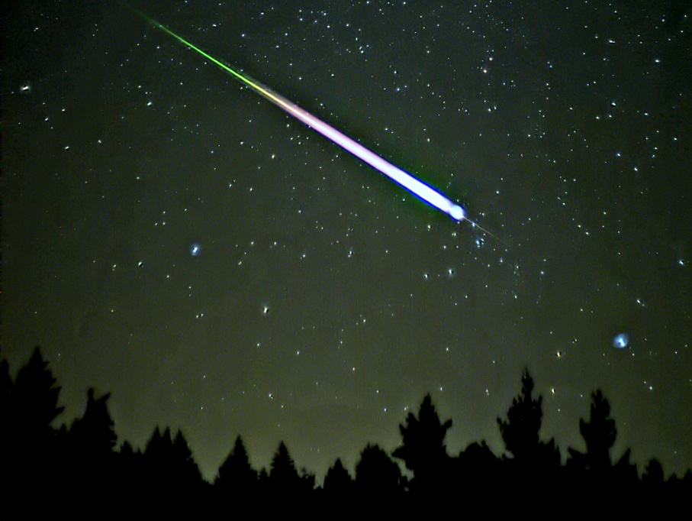
Burn Baby, Burn
Medium sized meteoroids simply burn up in a glowing vapor trail.

Slide 9
Burn Baby, Burn
Very small and very large meteoroids
reach the ground.
The middle sized meteoroids
just vaporize…

Slide 10
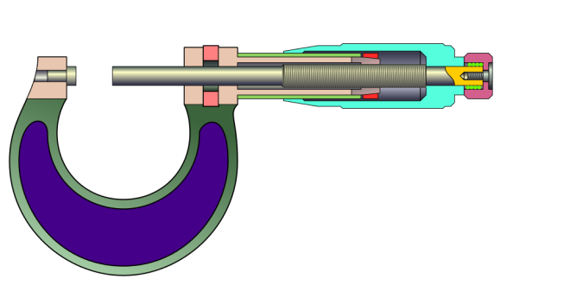
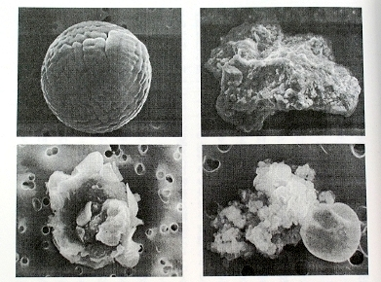
Surprise Delivery
Dust to sand-sized meteoroids arrive unseen.
The average one is scarcely a quarter of
the width of a human hair.
Fortunately,
that’s most of them!

Slide 11
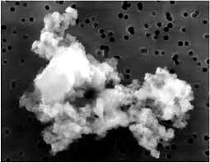
Surprise Delivery
The smallest meteoroids are so light they slow down easily.
They:
Don't meet intense friction
Don’t get vaporized
Most meteorites turn into
Fluffy Dust →

Slide 12
Surprise Delivery
The meteoroid dust drifts down through the atmosphere at
1 inch per second
50 miles = 3, 168,000 inches 525,600 seconds/ year
So…

Slide 13
Surprise Delivery
Most meteoroids…
…finally drift to the ground
6 years after they hit
Earth’s atmosphere.

Slide 14
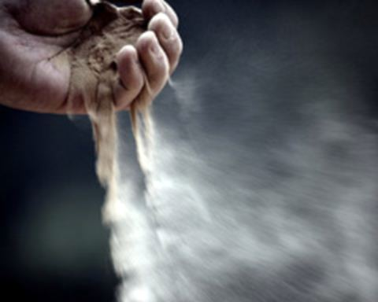
Missing in Action
They land, they are just NEVER SEEN.

Slide 15
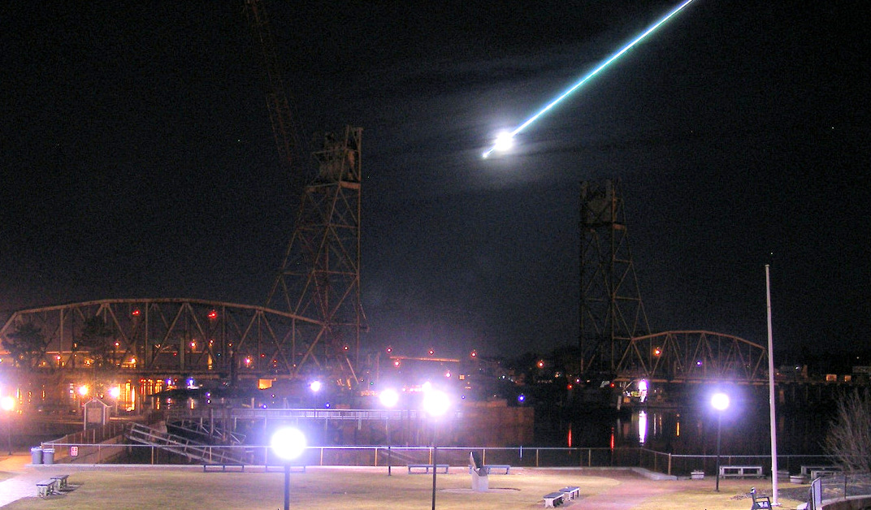
Missing in Action
→ Type 2. Sand grain to marble size… burn up as bright, beautiful “shooting stars”

Slide 16
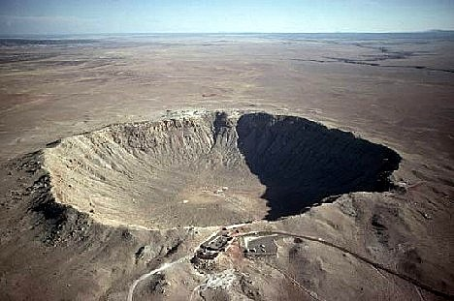
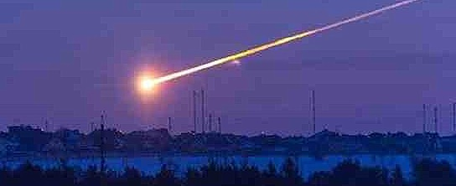
The Real Bullets!
Type 3. Marbles to Asteroid size… Seen as meteors
But most of it WILL hit the ground.

Slide 17
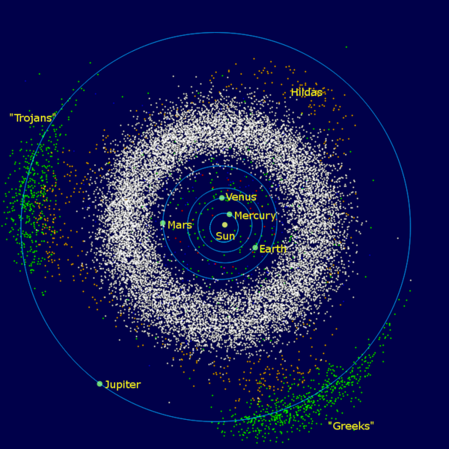
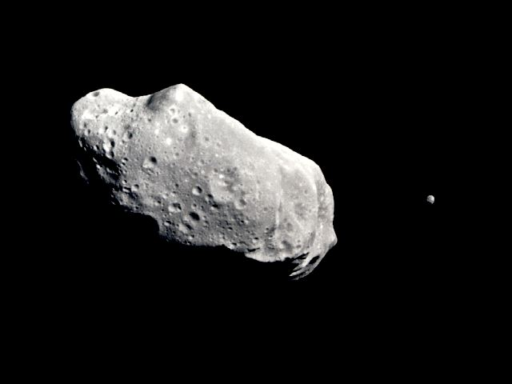
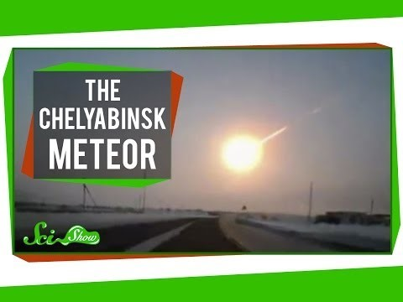
Meet the bullets
Asteroids
Meteors

Slide 18
The Shooting Gallery:
Mostly blanks
Type 1. Drifting dust – the most common kind.
Type 2. Streaks of fire, a little smoke…and gone.
Type 3. The only real bullets.

Slide 19
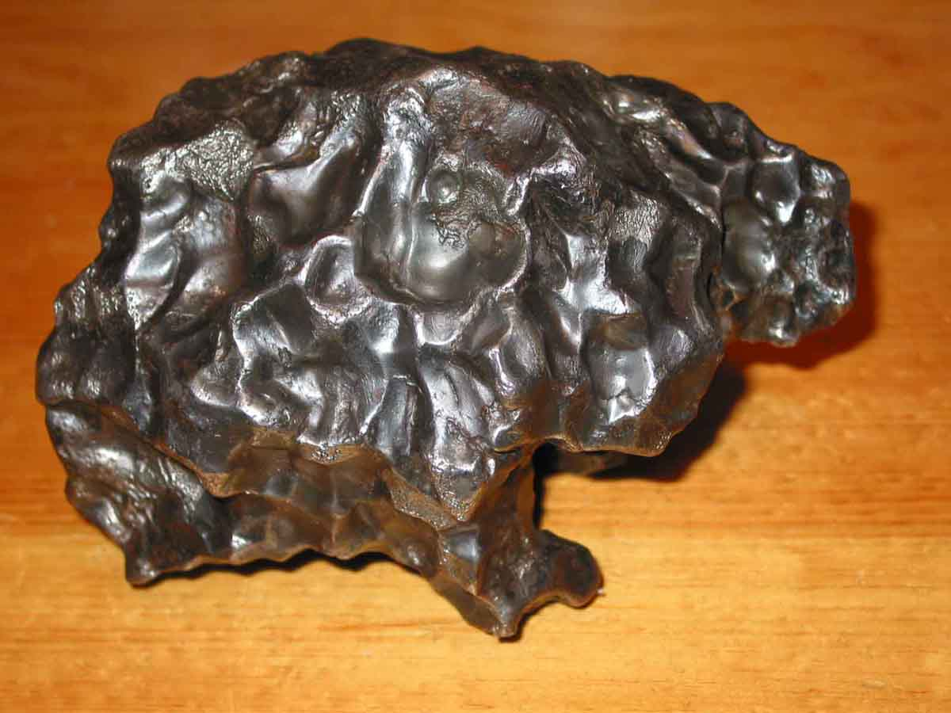
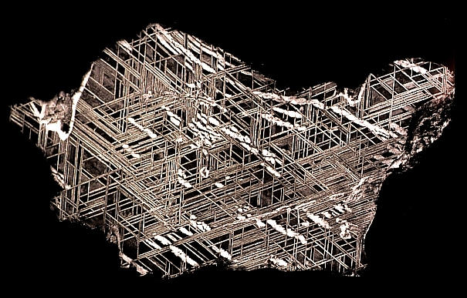
5 Kinds of Space Rubble
1. Iron Meteorites Only about 6 percent of all meteorites are made of iron & nickel.

Slide 20
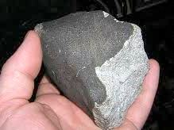
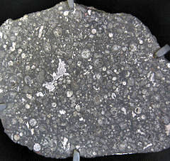
A Smörgåsbord of Rubble
2. Chondrites Stony meteorites make up 86 % of those seen to fall. They are hard to find, looking much like ordinary stones. Many contain organic chemicals. .

Slide 21
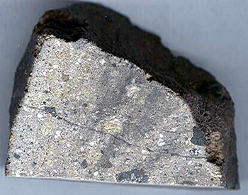
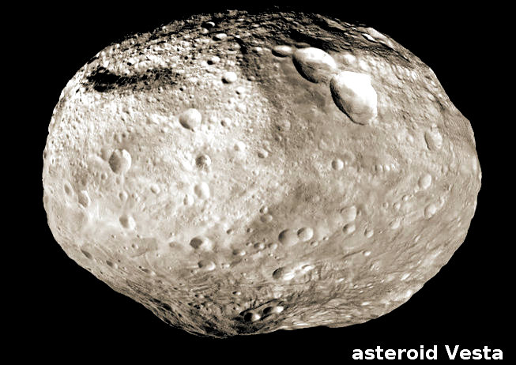
A Smörgåsbord of Rubble
3. Achondrites These are extremely rare. They come from the crusts of asteroids (60% of them from asteroid 4 Vesta), the Moon, Mars and other planets.

Slide 22
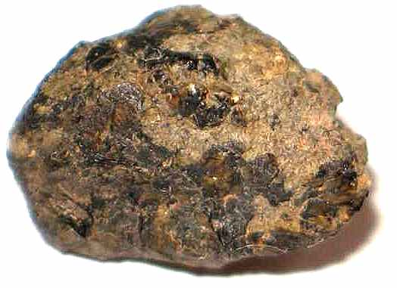
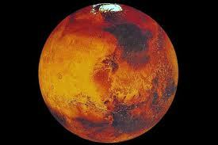
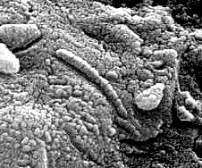
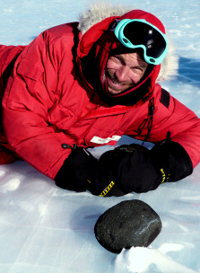
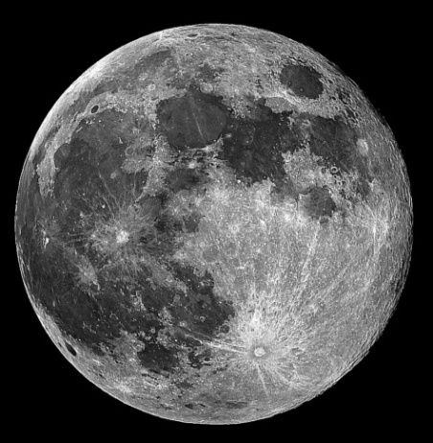
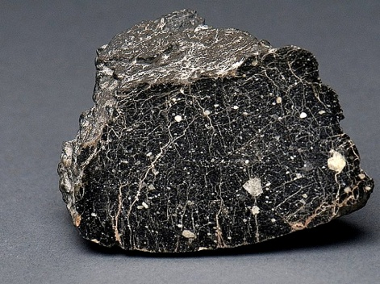
Verified from Mars and the Moon
Primarily Achondrites
Mars: 132
Moon : 258

Slide 23
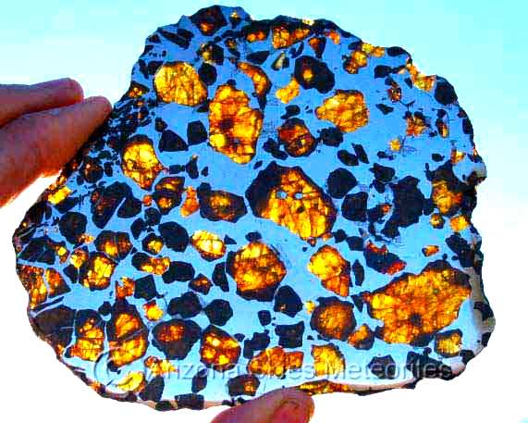
A Smörgåsbord of Rubble
4. Stony-Iron Meteorites are both rare (1 - 2 percent of falls) and beautiful, including the Pallasites.

Slide 24
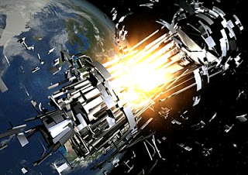
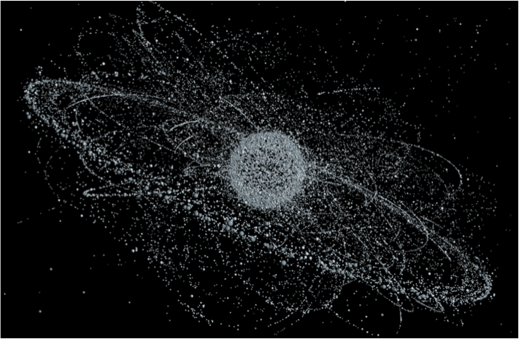
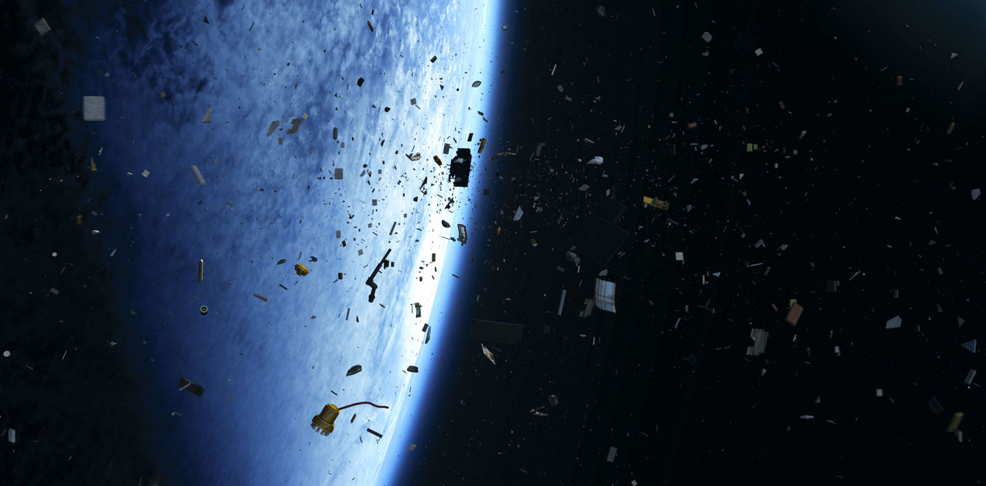
A Smörgåsbord of Rubble
5. Satellite reentry debris
SPACE JUNK

Slide 25


What Comes Down
The biggest impacter to hit Earth:
On any day is likely to be about 16 inches,
In a year it is likely to be about 13 feet,
In a century it is likely to be about 65 feet.
Every 2 million years a 1.25 mile asteroid
(explosive force = one million megatons of TNT) .

Slide 26
What Comes Down
Recent Estimate:
(NASA)
36,500 tons of meteoroids enter Earth’s atmosphere
every year worldwide.
100 tons/day
Fe/Ni meteoroids = ~6 tons/day

Slide 27

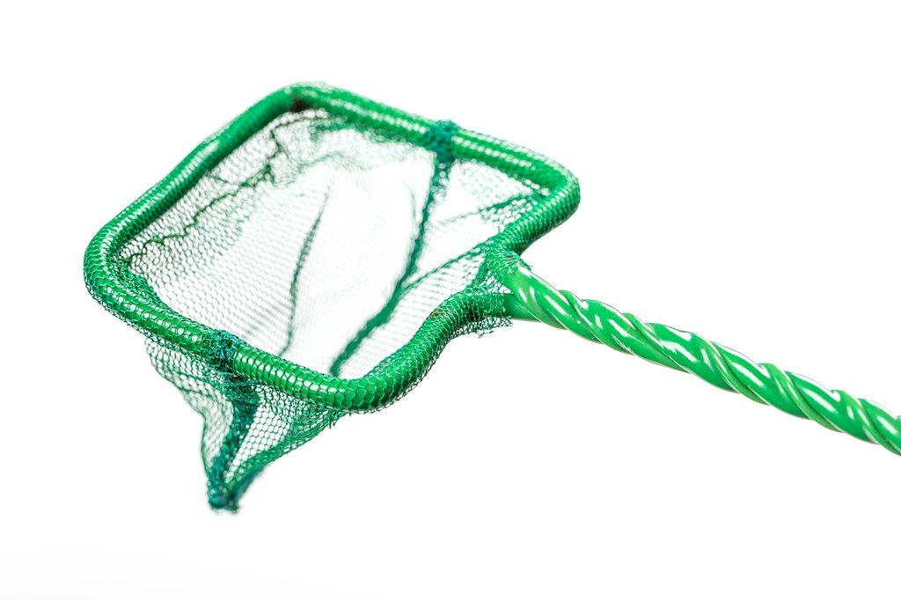
How NOT to collect meteorites!
The Martz/Kohl Observatory Frewsburg, New York

Slide 28
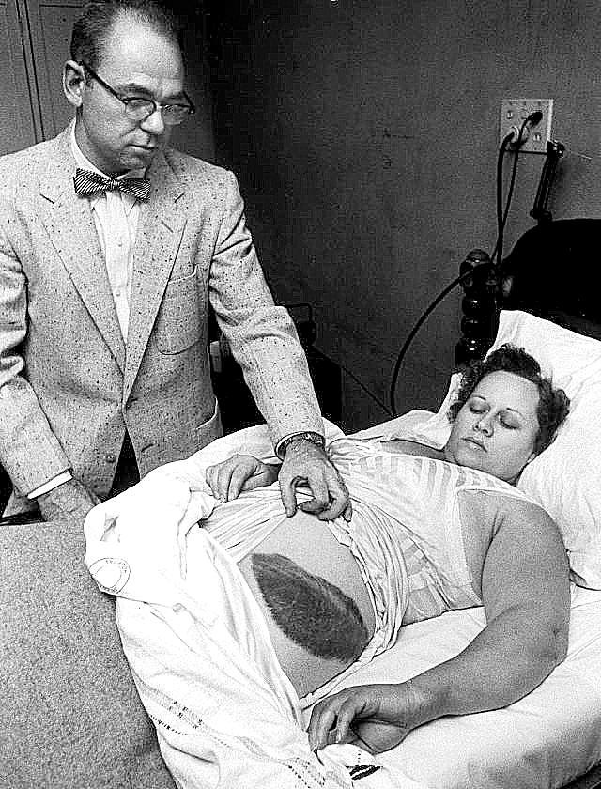
How NOT to collect meteorites
Only Known Meteorite Victim
Ann Hodges was hit by an 8-pound meteorite in her
Alabama home in 1954.
"I feel like the meteorite is mine," Ann said,
"I think God intended it for me. After all,
it hit me!"
People in tiny Sylacauga, Alabama and
across eastern Alabama had reported seeing
"a bright reddish light like a Roman candle
trailing smoke."

Slide 29
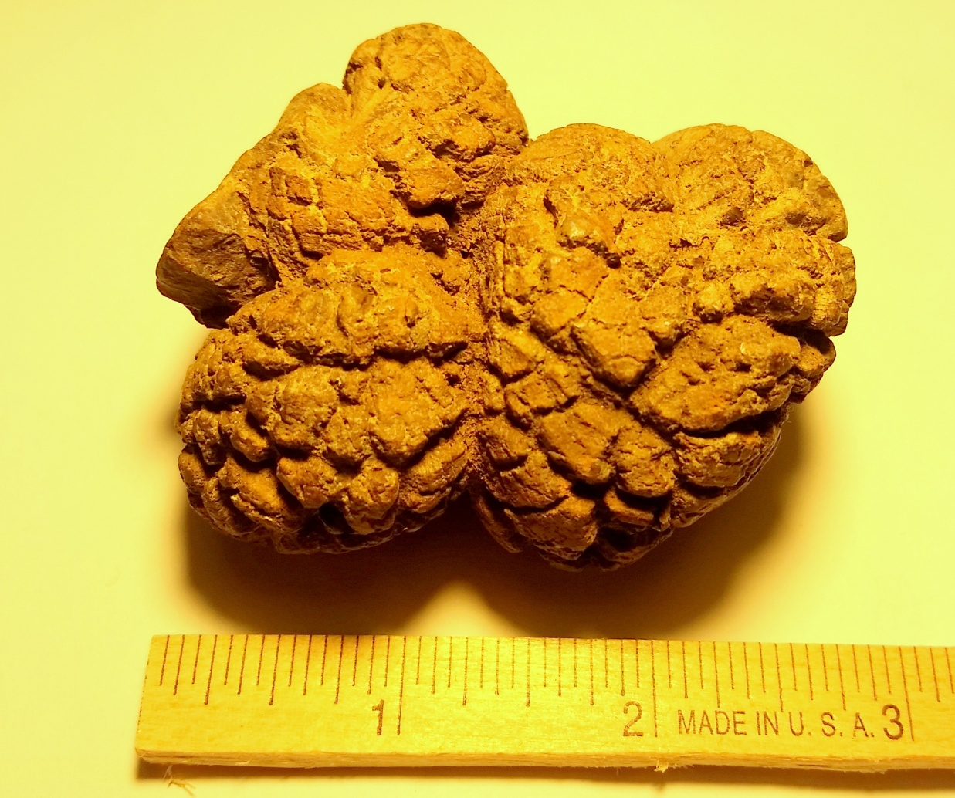
Don’t be fooled…
Not a meteorite, but if ET
left this, it would be a bad
sign for Interplanetary
Diplomacy.
This is a terrestrial mineral
specimen
of Coprolite*.
*Petrified, 35 million year
old dinosaur droppings

Slide 30

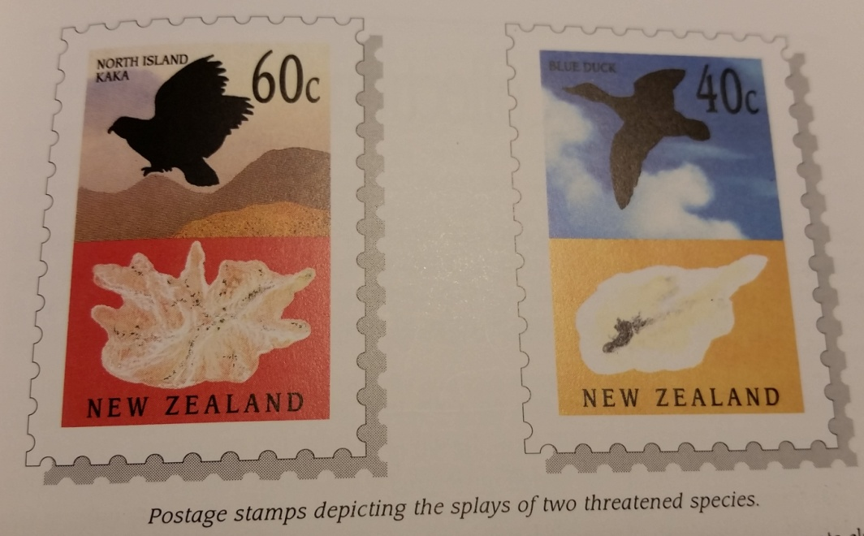
Not a possible contaminant
Meteor collector collect many
substances, but probably not
meteor dust.

Slide 31
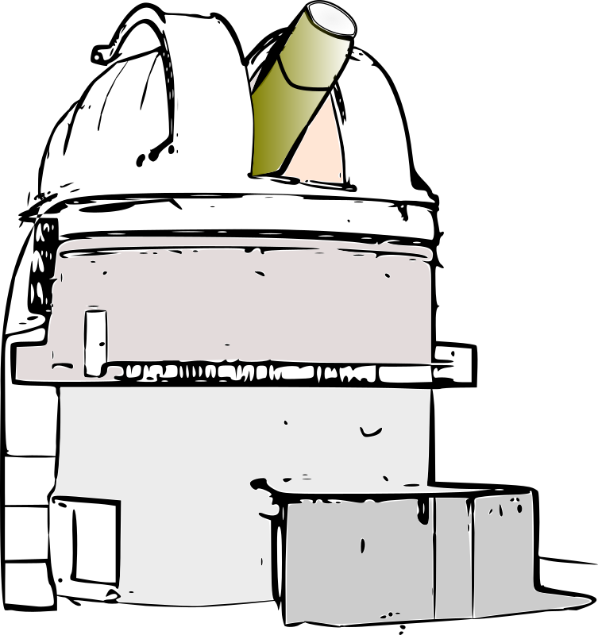
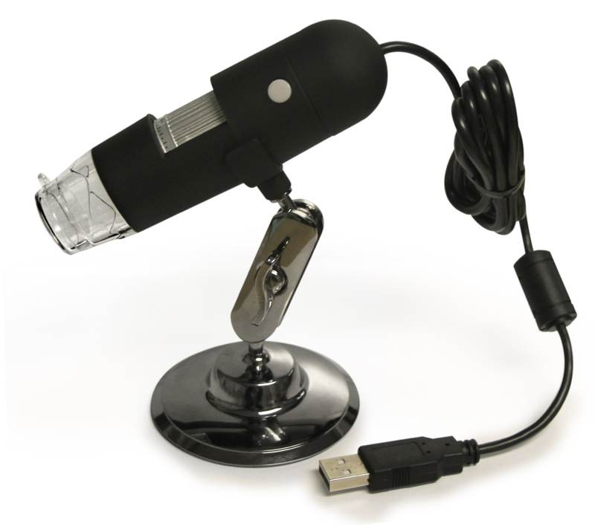
A Closer Look
When it comes to meteorites,
The other end of a telescope…
…is a microscope.

Slide 32
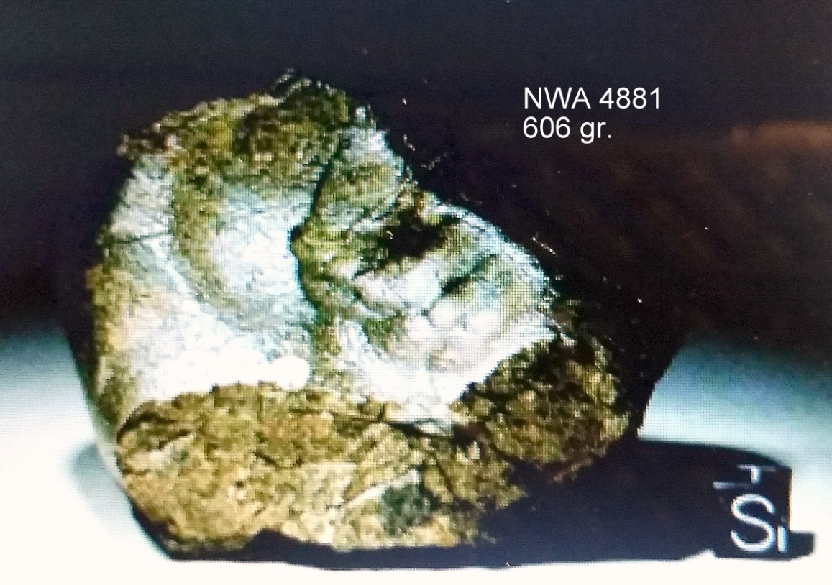
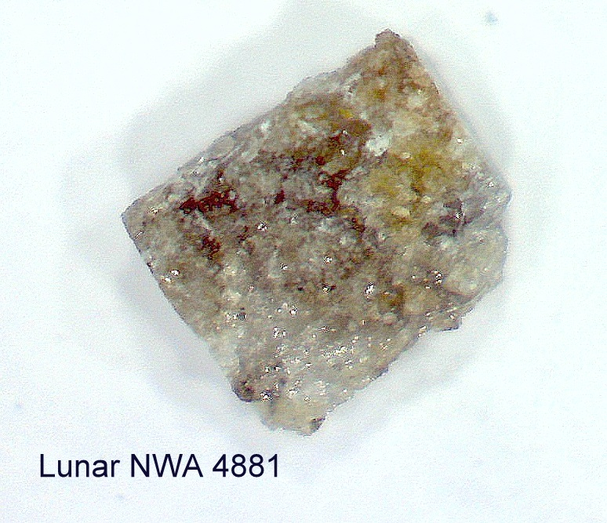
Micro-Astrophotography
Northwest Africa 2005
Achondrite, feldspathi Granulocytic brecchia
The Moon

Slide 33
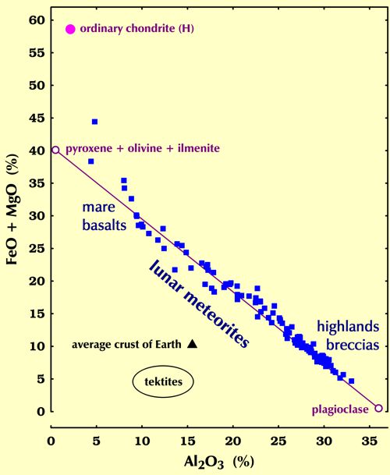
Origins
Only four minerals:
  plagioclase feldspar
  Pyroxene
  Olivine
  Ilmenite
account for 98-99% of all the
crystalline material of the lunar crust.
  Mg
  Fe
  Al
  Ca
  Ti
  Si
  O

Slide 34
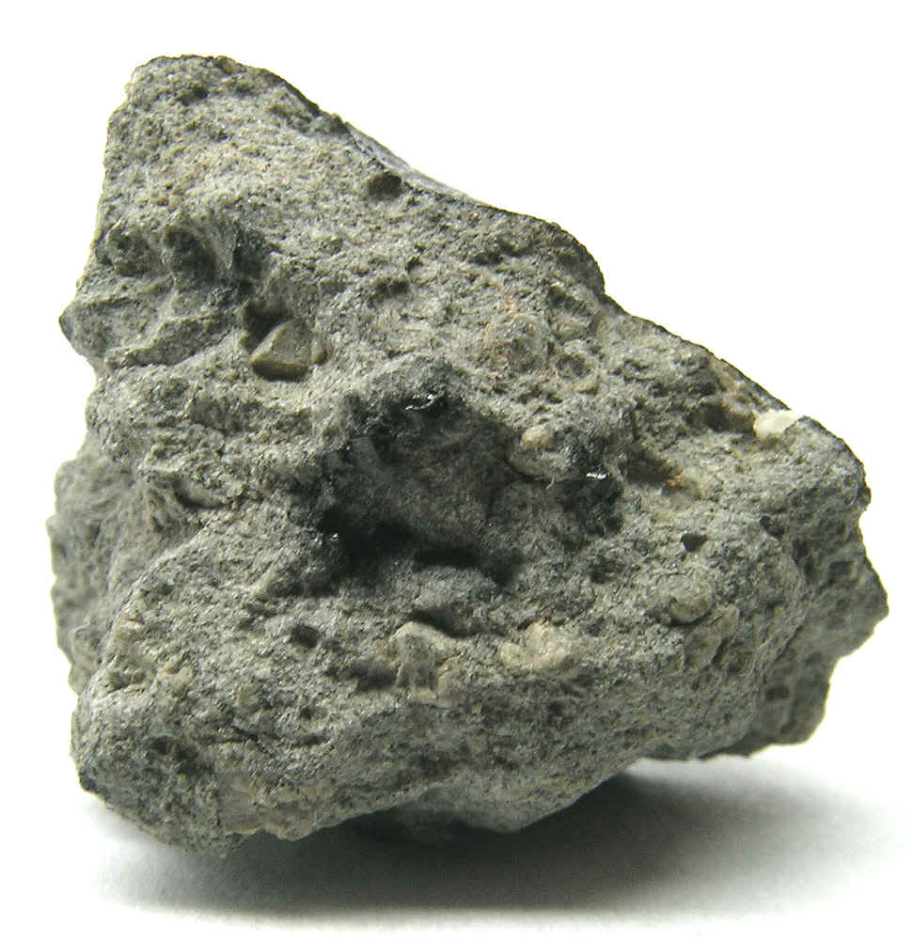
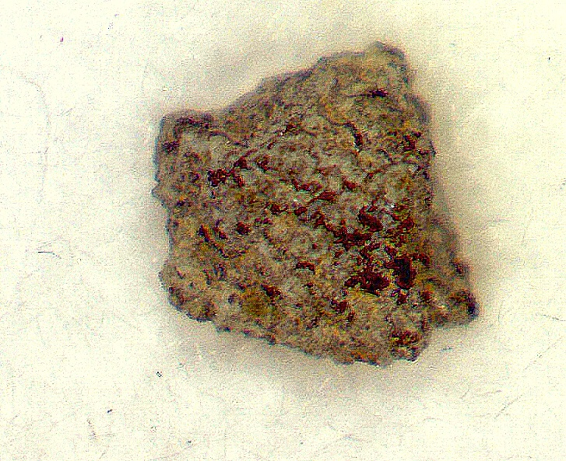

Micro-Astrophotography
Mars
Shergottite (achondrite)

Slide 35

Analysis
Shergottite
Mars
Origin
Verified

Slide 36

Collecting Space Dust
Most space dust is carbon, the stuff chondrites are made of.
It is indistinguishable from common soot.
Metallic space dust is potentially
identifiable with a magnet.
Method 1. Strain the water from your pool and run a magnet through the debris.
Method 2. Place a magnet in the down spout of your roof gutter.
Method 3. Fly a high altitude plane to the edge of space with an air filter.
Method 4. Draw high volumes of air past high intensity magnets.

Slide 37

6 Tons of iron fall every day
75% falls over oceans
25% falls over land
.25 x 6 = 1.5 tons of Landfall
The total land surface area of Earth is about
57,310,000 square miles
0.3 oz. / year/sq. mi. (~8.5 gr.)

Slide 38
6 Tons of iron fall every day
75% falls over oceans
25% falls over land
.25 x 6 = 1.5 tons of Landfall
The total land surface area of Earth is about
57,310,000 square miles
0.3 oz. / year/ sq. mi. (~8.5 gr.)
.00085 oz. day/ sq. mi. (~2.4 mg.)

Slide 39

Dust Collection
Four weeks collection on a glass top table outdoors (20 wet wipes)
NO DETECTABLE MAGNETIC MATERIAL FOUND

Slide 40
Meteor Catcher
Electromechanical-magnetic (120 CFM)
Turbulent precipitation
→ 200 hours of continuous throughput.
Observation:
Very scant possible dust

Slide 41
The final tale of the dust
A NASA scientist has concluded that filtering or catching meteor dust appears to be a myth.
Tens of thousands of tons of anthropogenic particulates are thrown into the sky daily by engines of all kinds, many of them magnetic and roughly spherical.
The worst are coal-fired power plants that not only produce dark, metallic fly ash but also spread it far and wide.
With most estimates of ET debris input in the 20-40,000 ton per year, and only a small proportion of it durable metallic spheres, you can see the problem.
When I was a grad student (working on micrometeorites), I and others tested the "rain gutter and magnets" theory and couldn't find a single particle out of many thousand we looked at that had a composition more consistent with an extraterrestrial origin than an anthropogenic origin.

Slide 42



Catch the bullet!
Meteorite collecting is possible, enjoyable and
maybe even profitable.

Slide 43

Feel safer yet?
Not so fast!...
The universe has a few more bullets coming our way.
Here’s one of MKO’s most experienced astronomers,
Tom Traub, to give you a few more things to worry about.
The Martz/Kohl Observatory Frewsburg, New York

